Slide 1
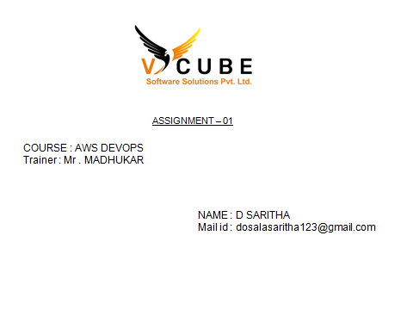

Slide 2
Create transit gateway in two different account

Slide 3
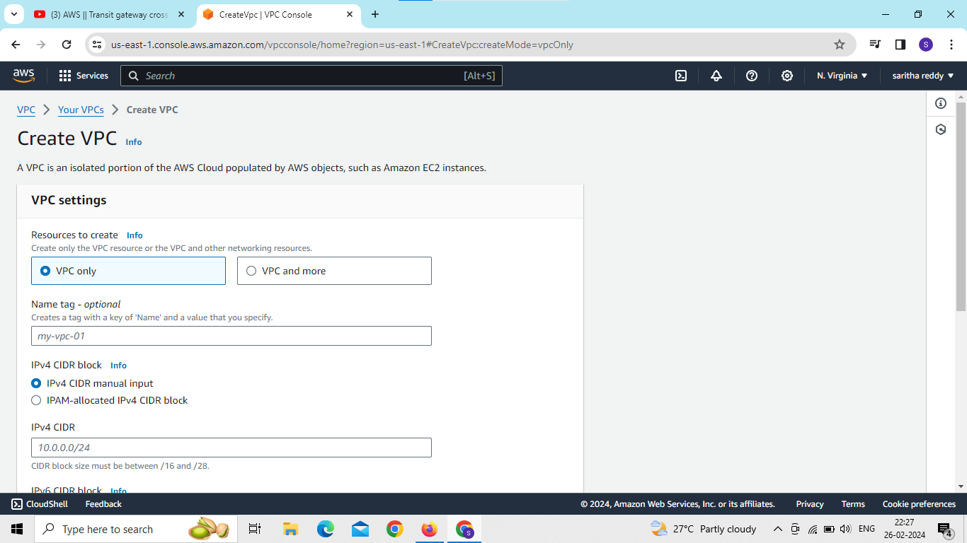
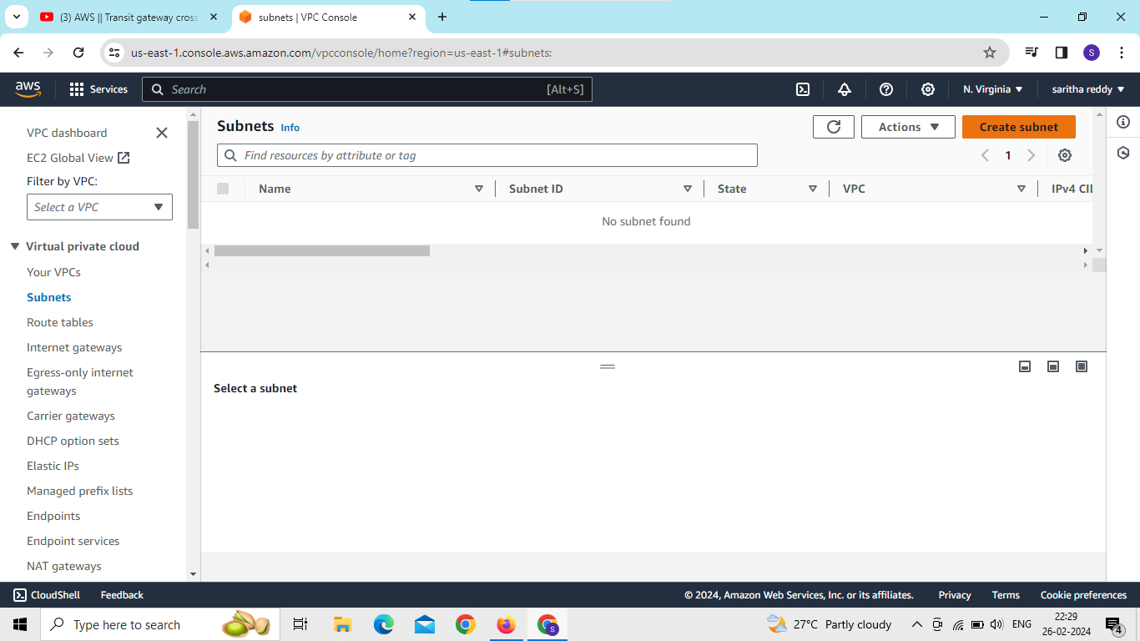
create vpc,subnets,internate gateway in account1

Slide 4
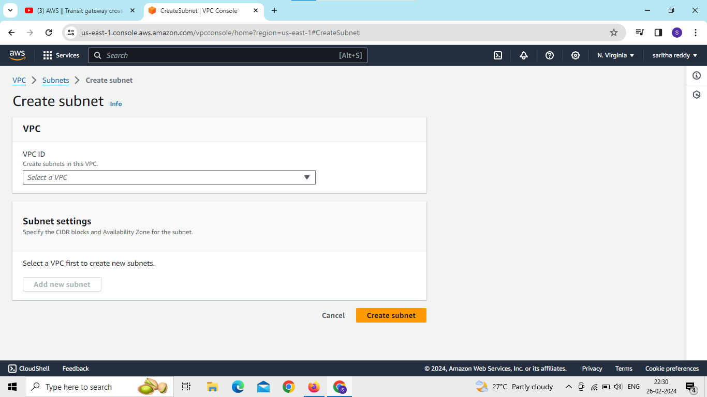
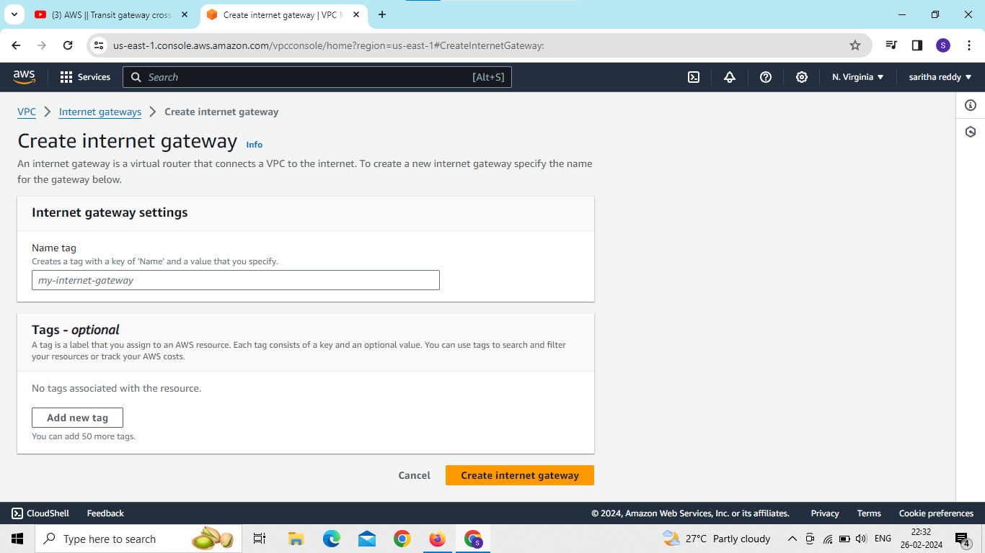

Slide 5
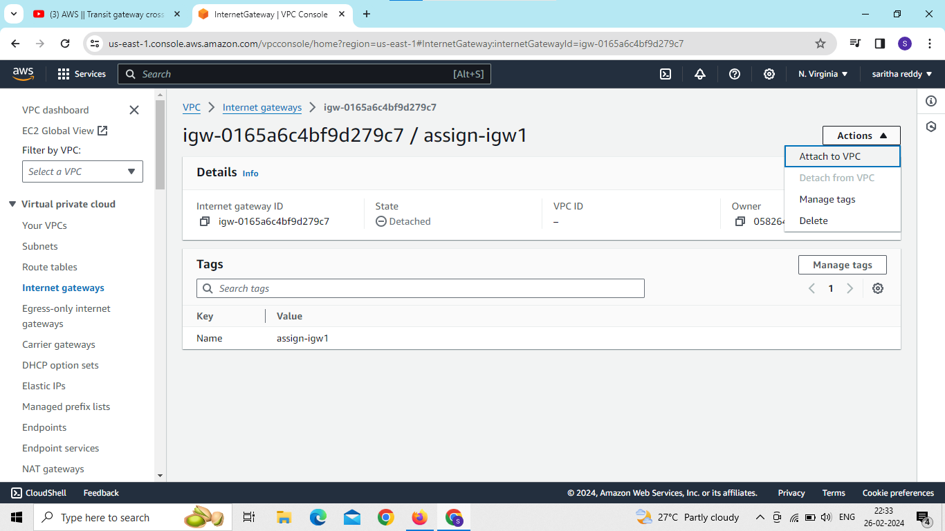
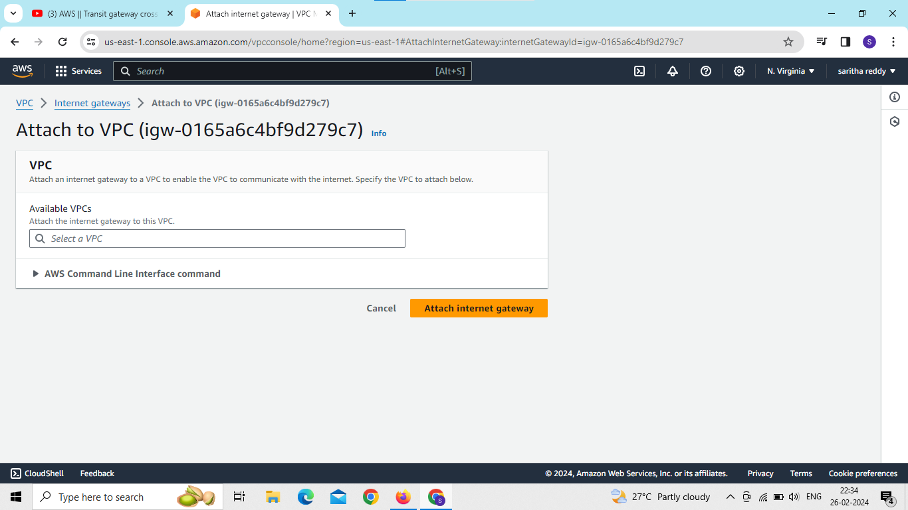
attach internategateway to vpc

Slide 6
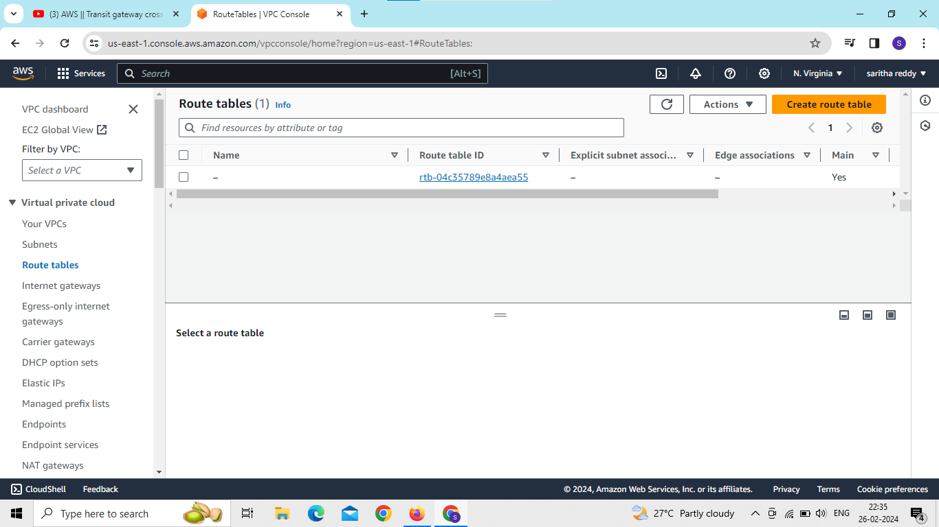
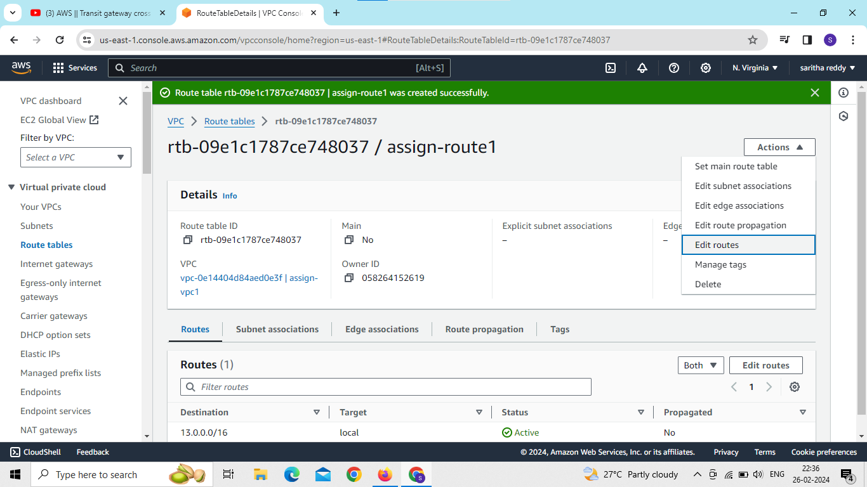
create route tables and edit routes and subnet association

Slide 7
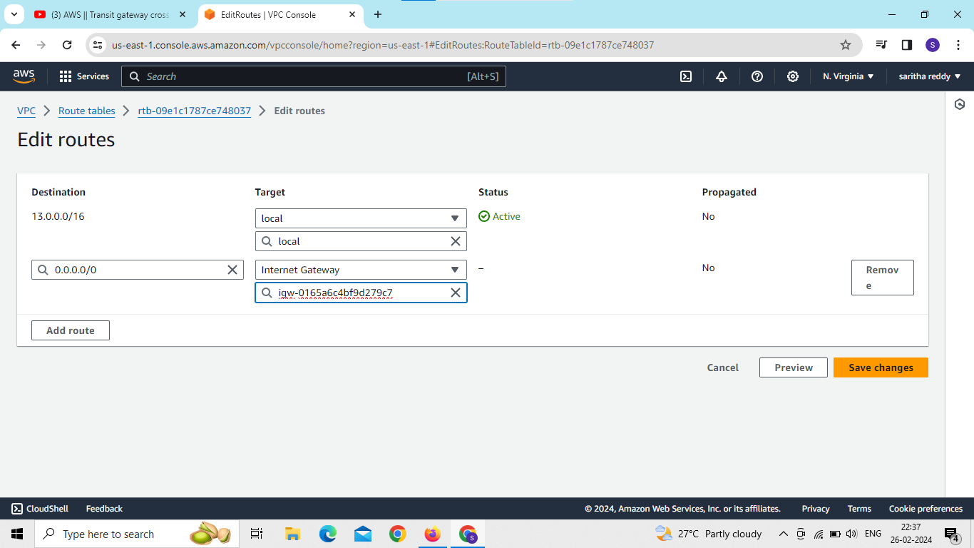
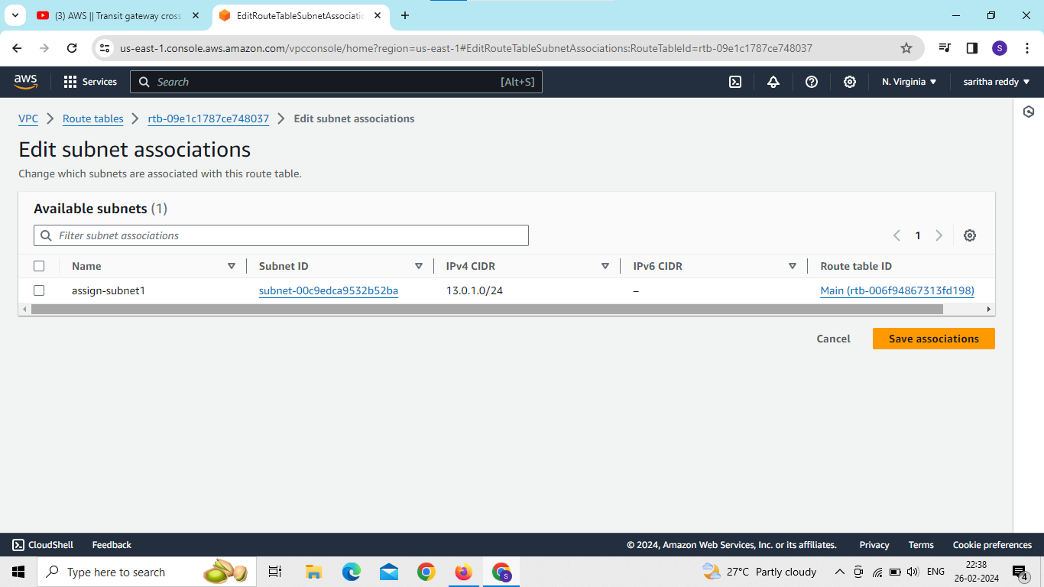

Slide 8
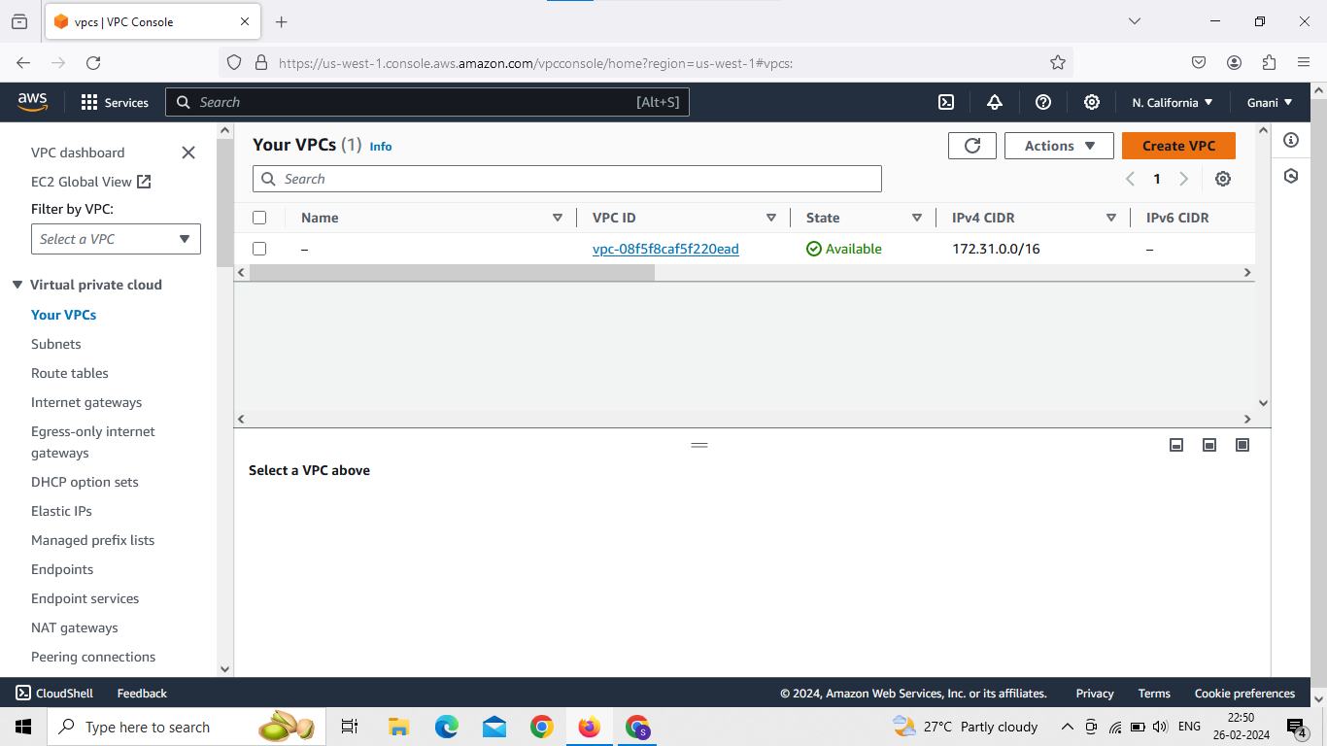
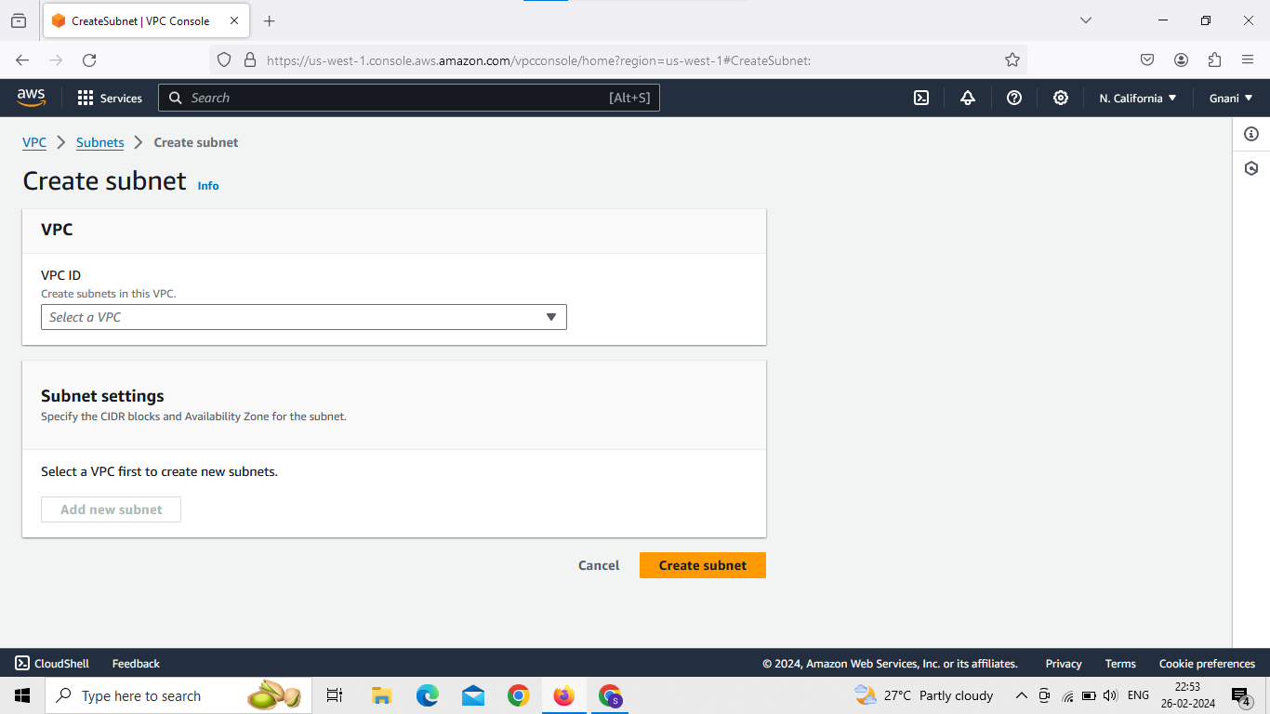
create vpc,subnets,internategateway attach internategateway to vpc in account2

Slide 9
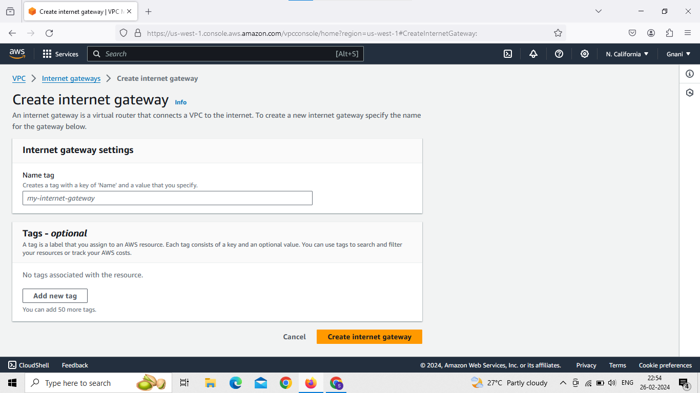
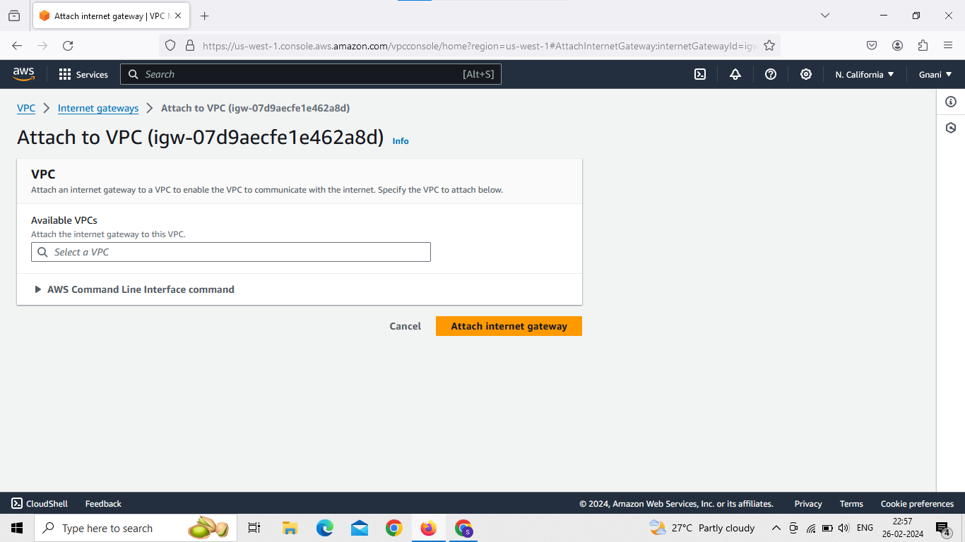

Slide 10
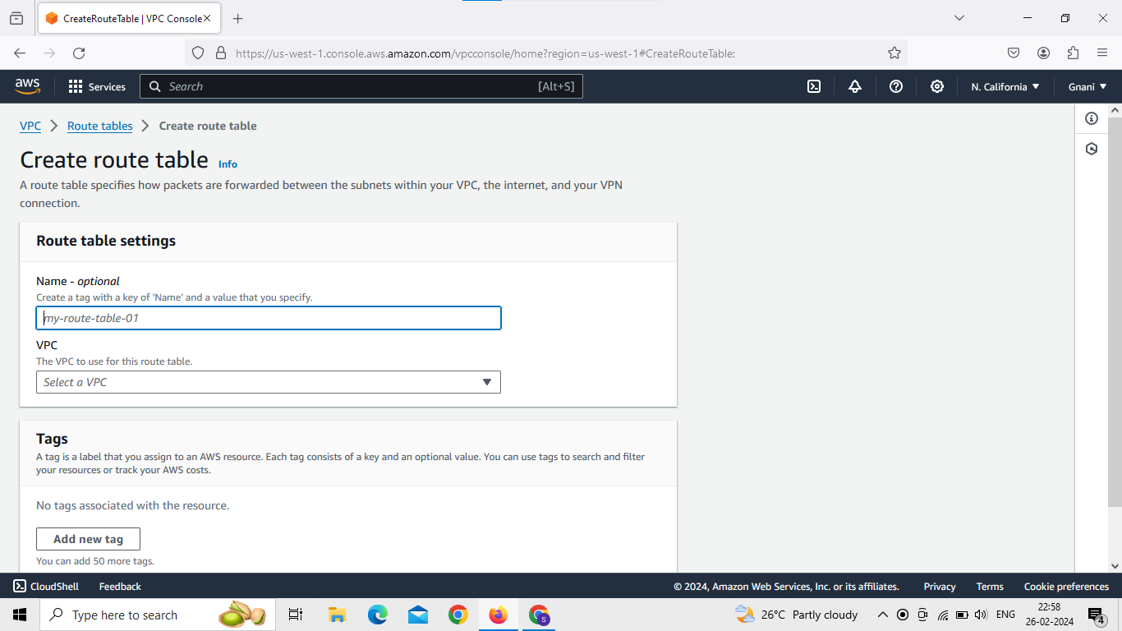
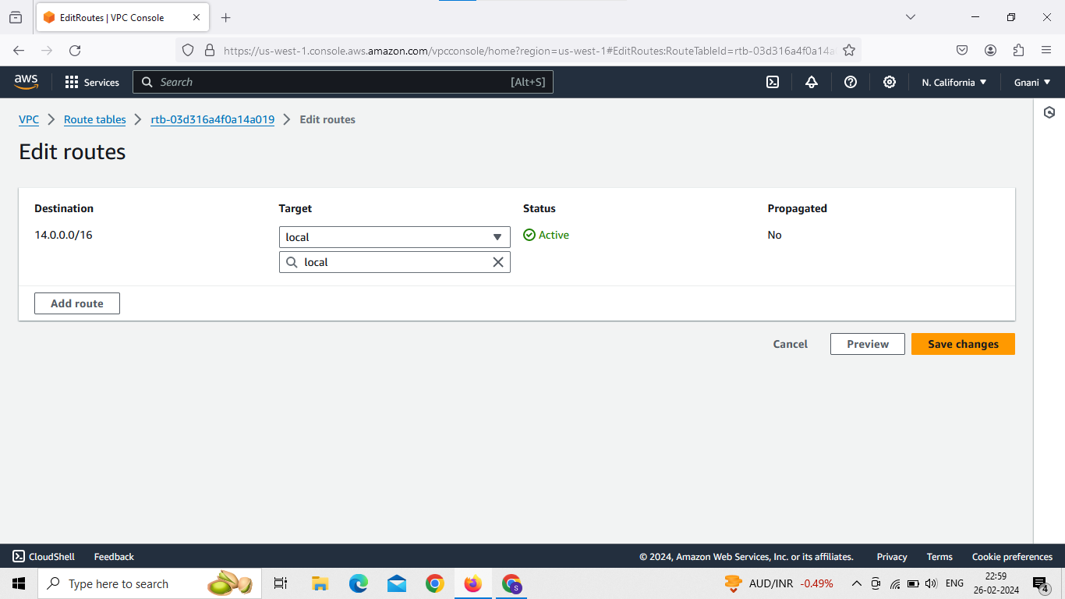
create route tables and edit routes and subnet associations

Slide 11
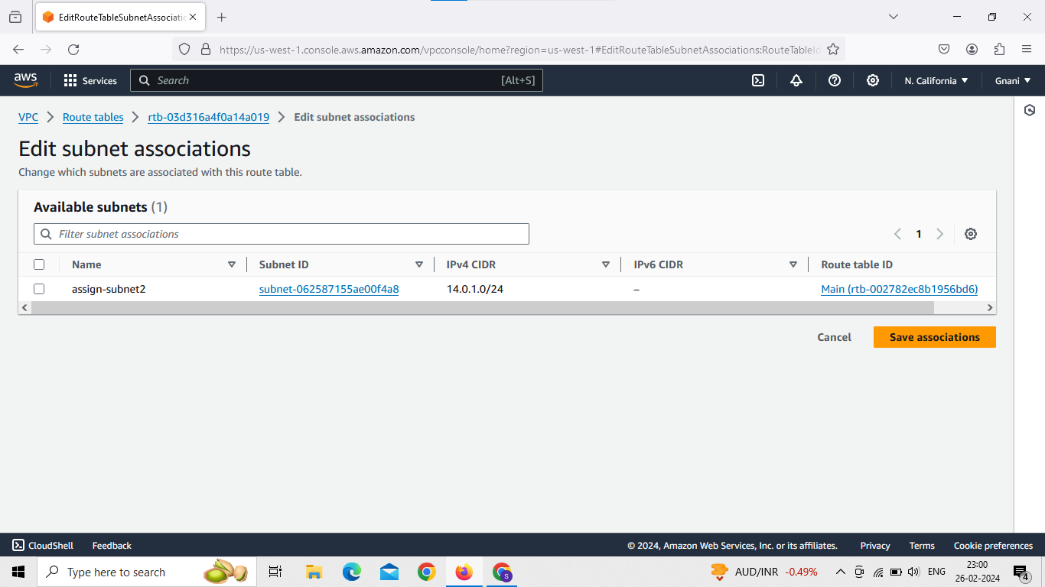

Slide 12
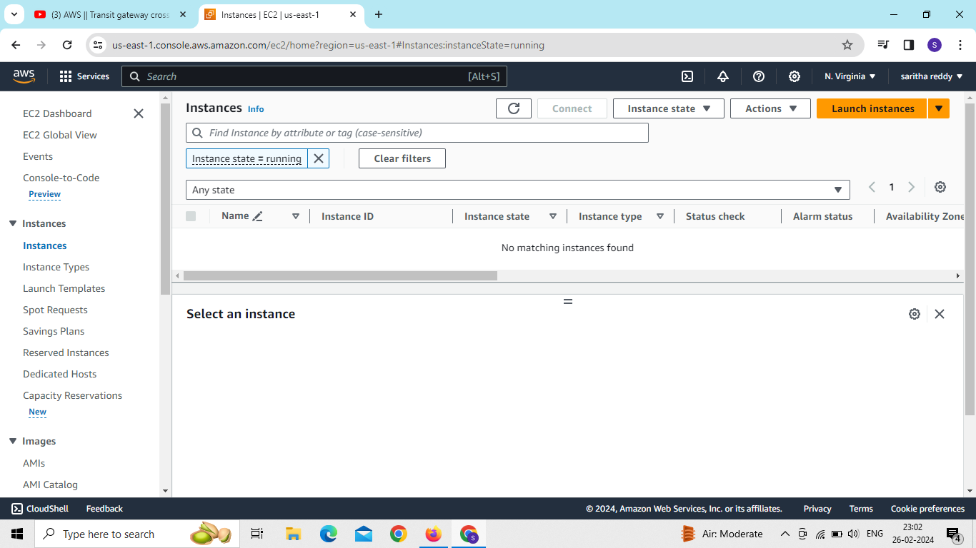
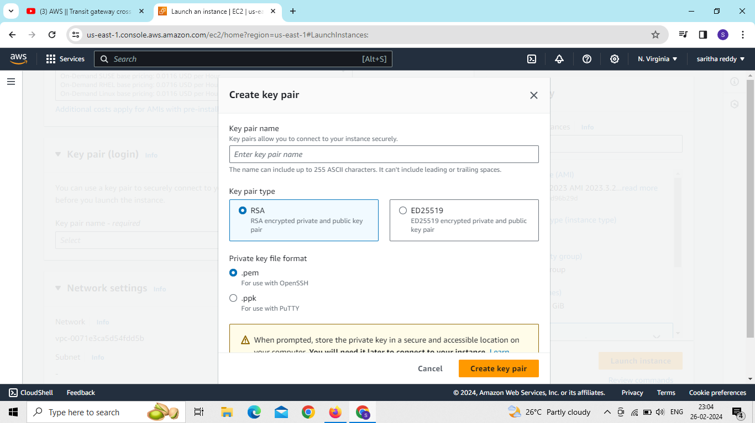
launch EC2 instance for account1

Slide 13
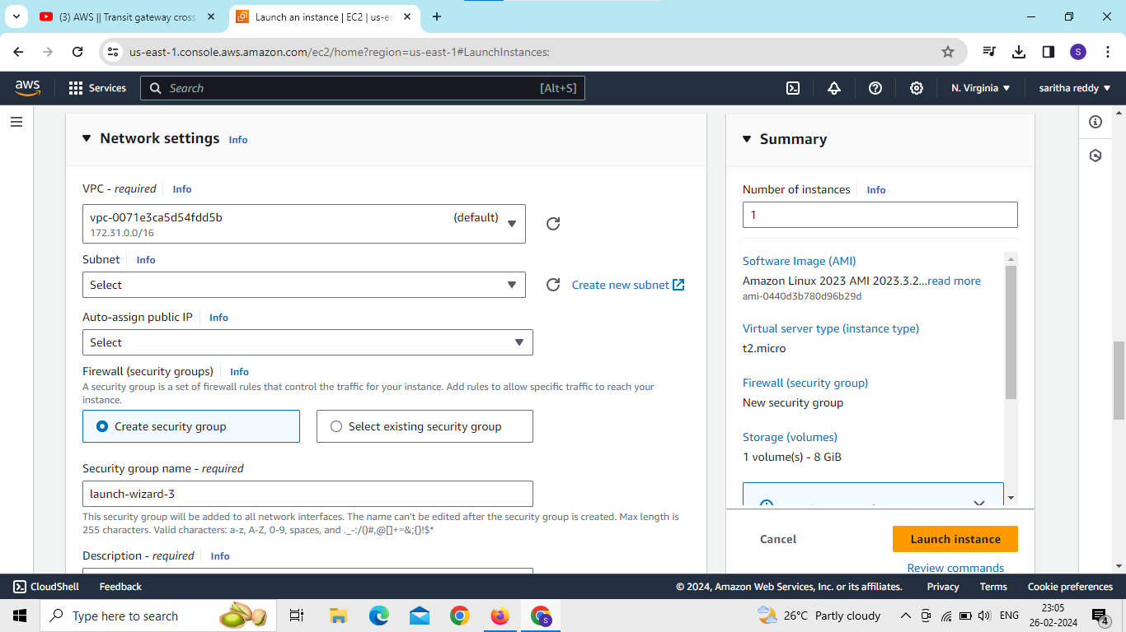
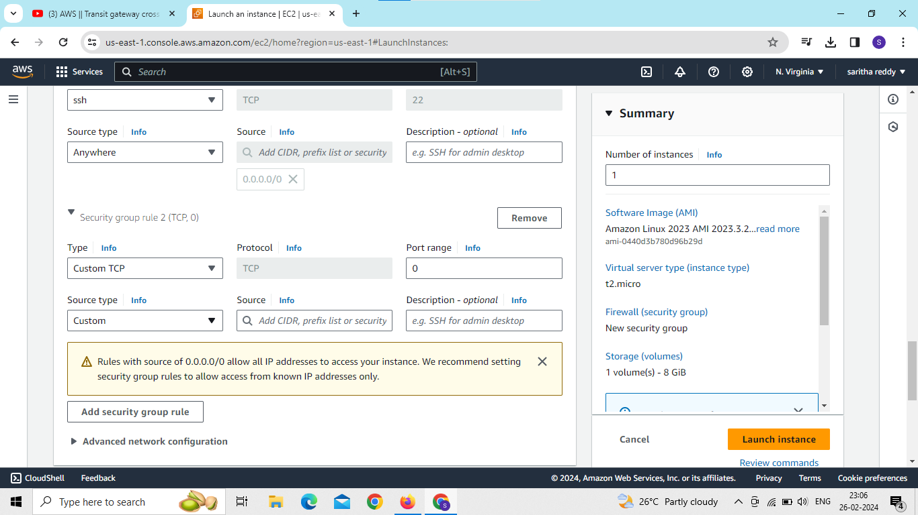
edit network settings and add security group rule

Slide 15
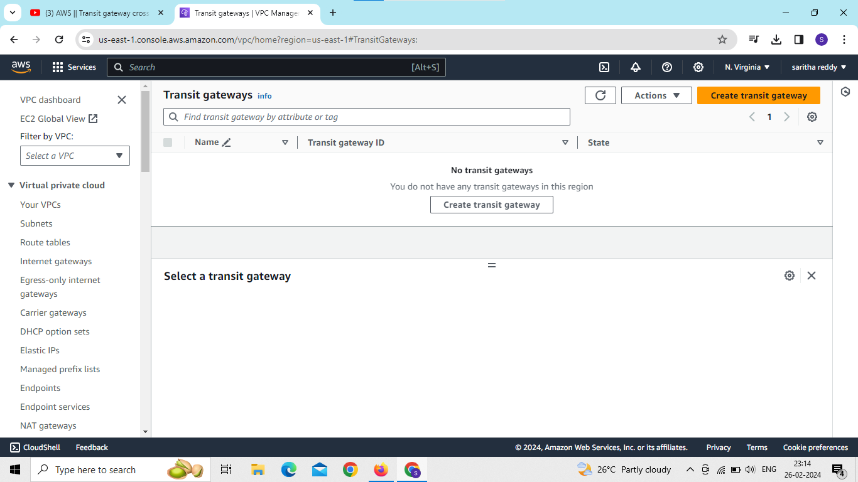
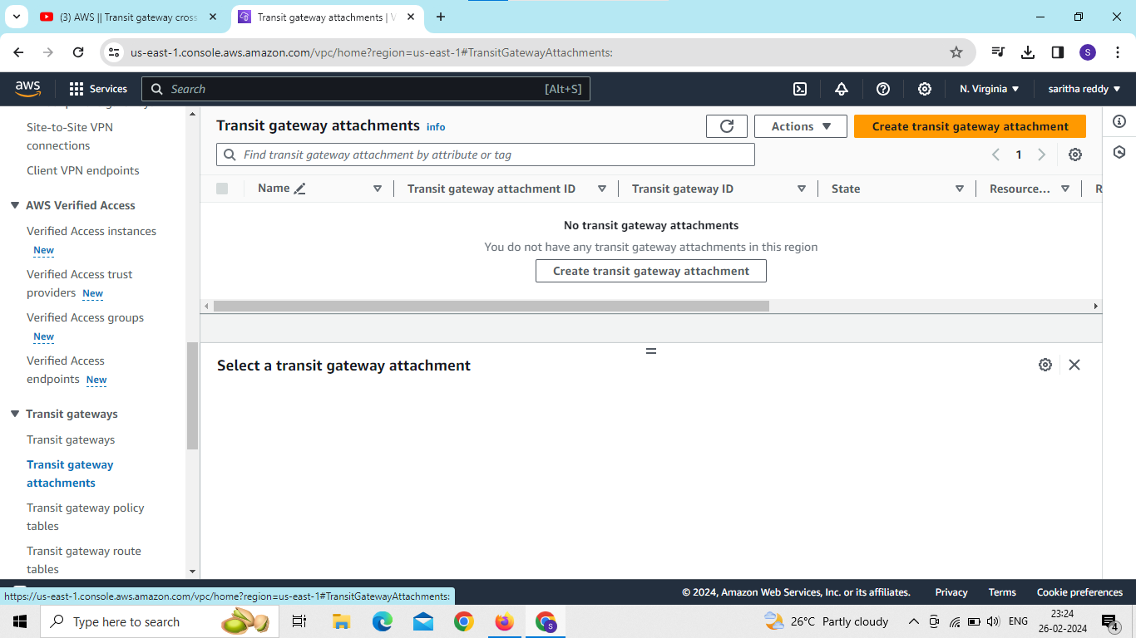
create transit gateway and transit attachment of account1

Slide 16

now go to route tables and edit routes

Slide 17
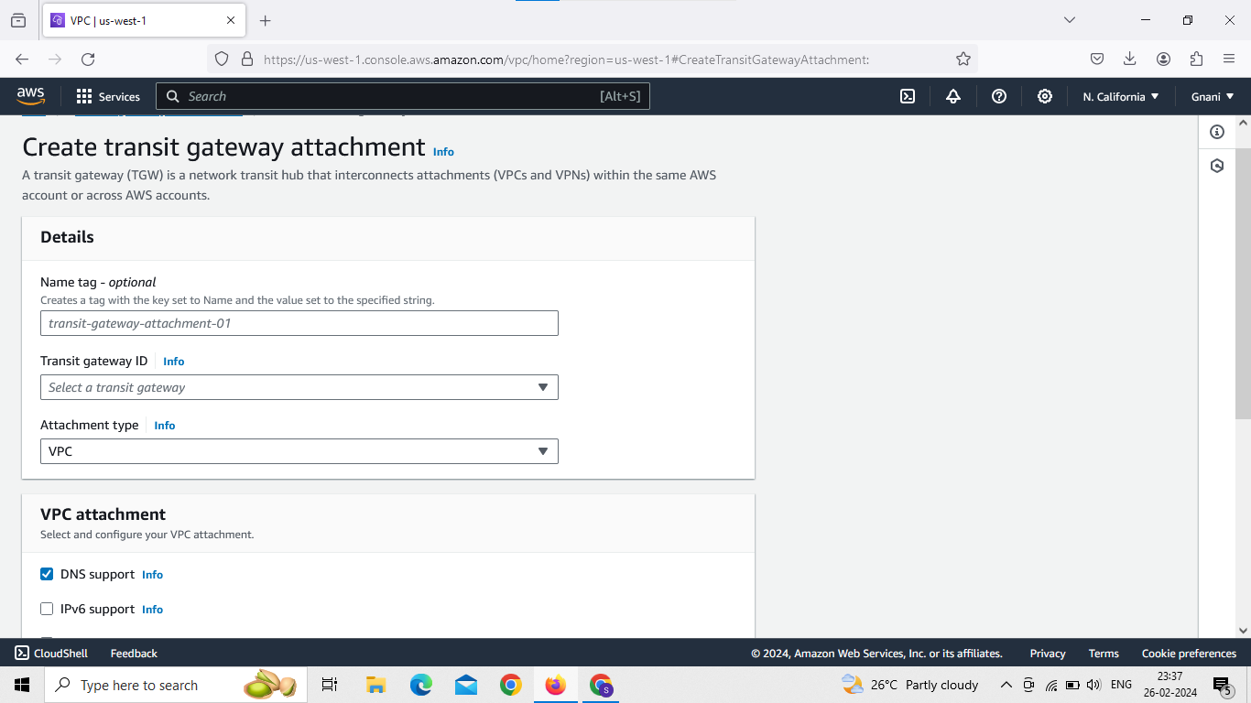
create transit gateway attachment of account2

Slide 18
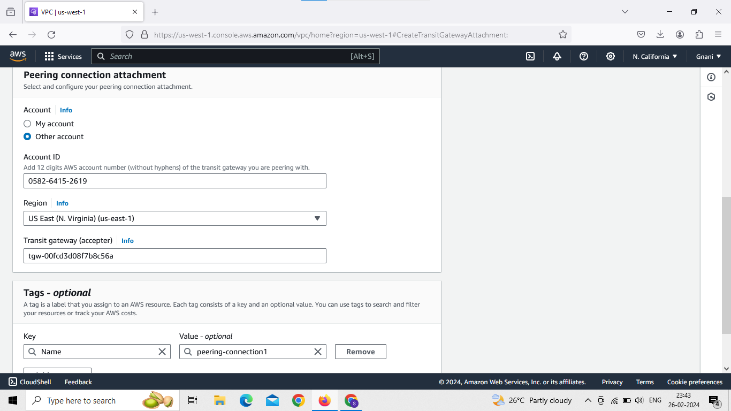
Enter name and select transit gateway id
And select attachment type is peering connection then selects other account option
And enter other account id,region and transit gateway id of accepter then create transit gateway attachment

Slide 19
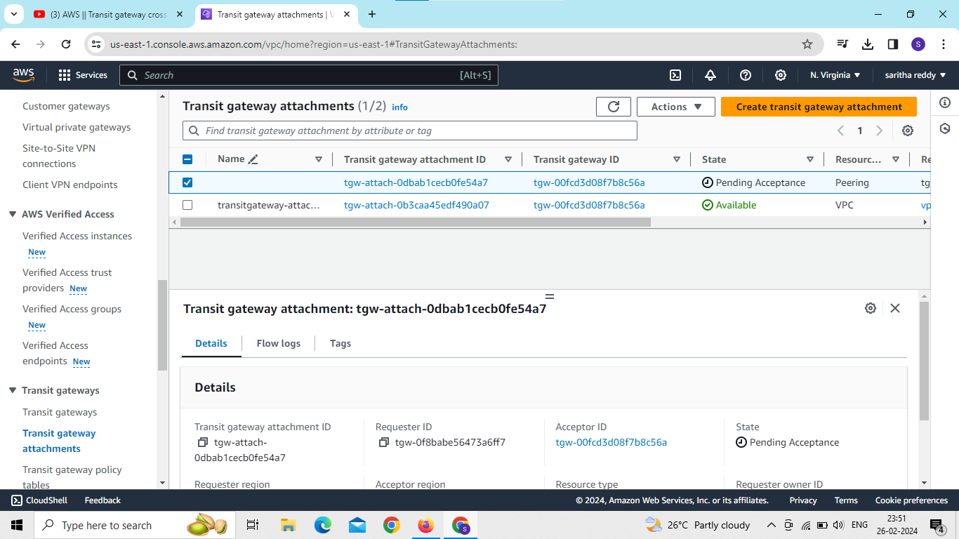
go to acceptor account and go to transit gateway attachments and its showing status pending acceptance click on that attachment id then accept transit gateway attachments

Slide 20
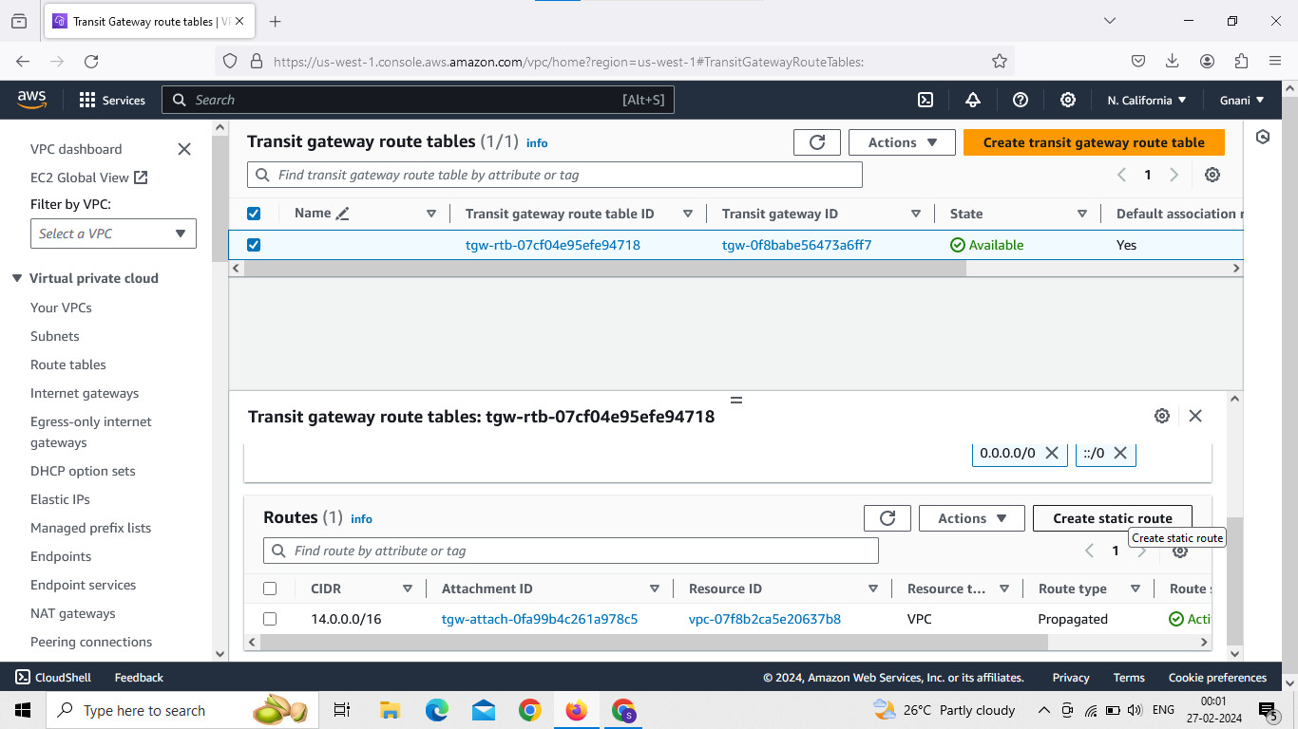
create static route table of both the accounts

Slide 21
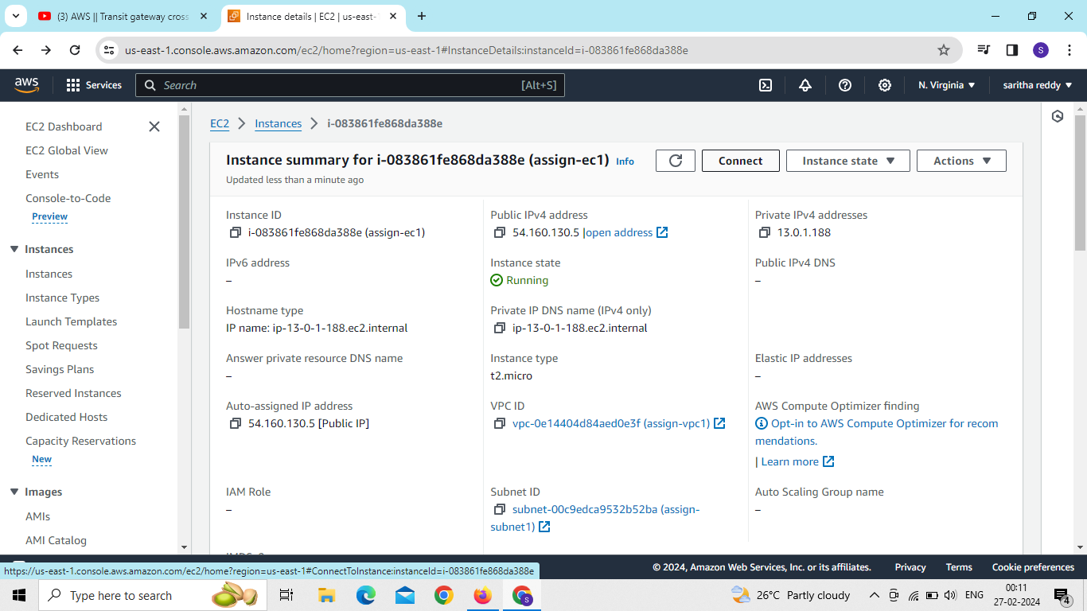
connect to ec2 instance of account1

Slide 22
We use commands
Sudo –i
Yum install nginx –y
Cd/usr/share/nginx/html
Ls
rm index.html
Vi index.html
Cd
Systemctl restart nginx
Systemctl stastus nginx
Curl.private ip of account 1 or 2

Slide 23
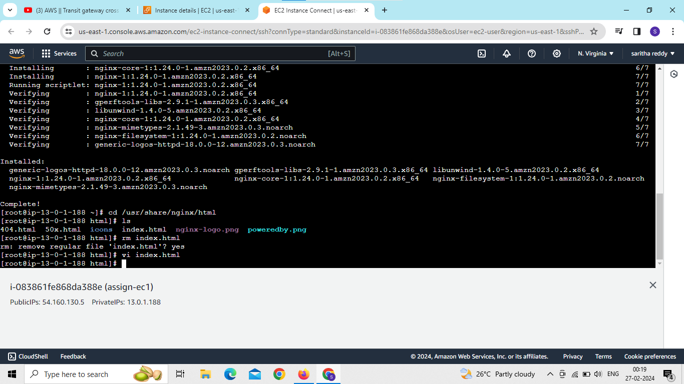
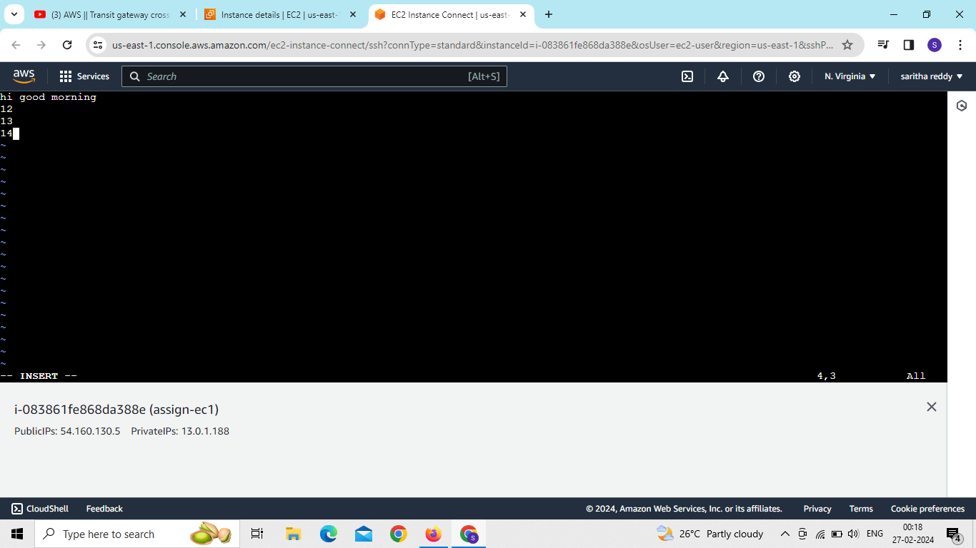

Slide 24
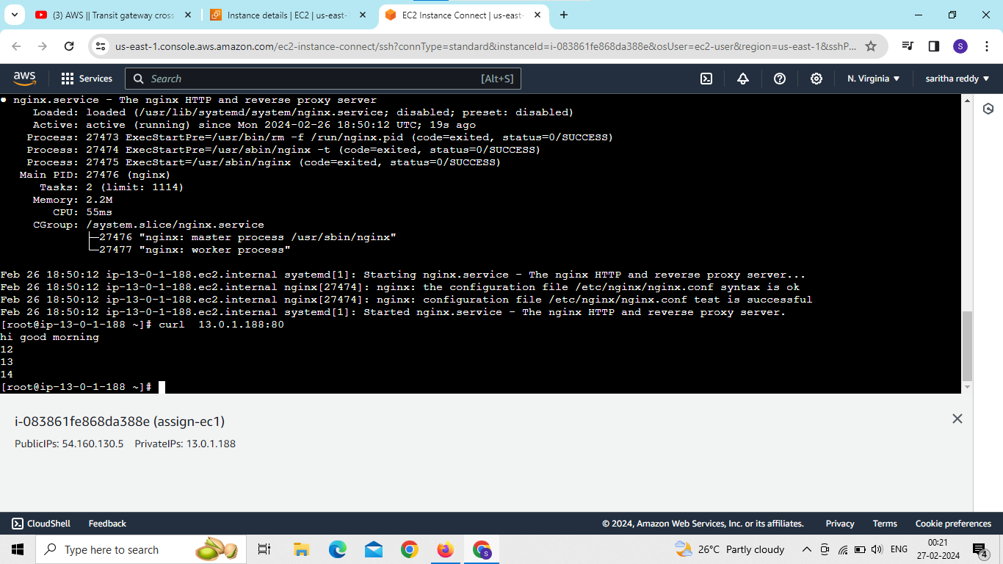

Slide 25
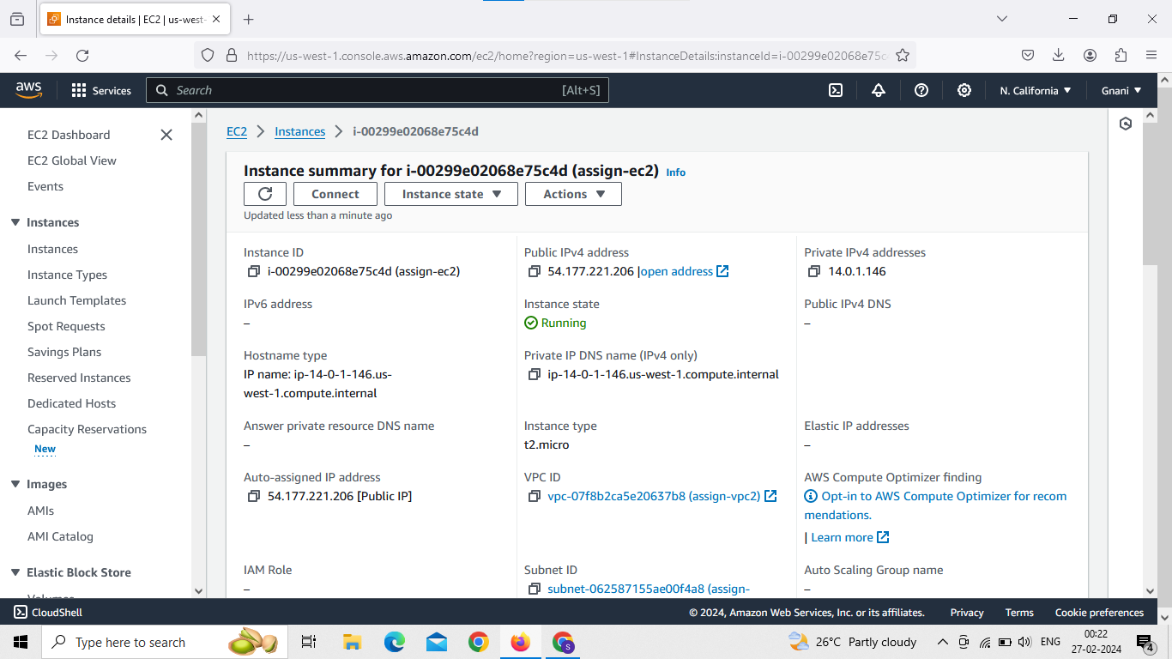
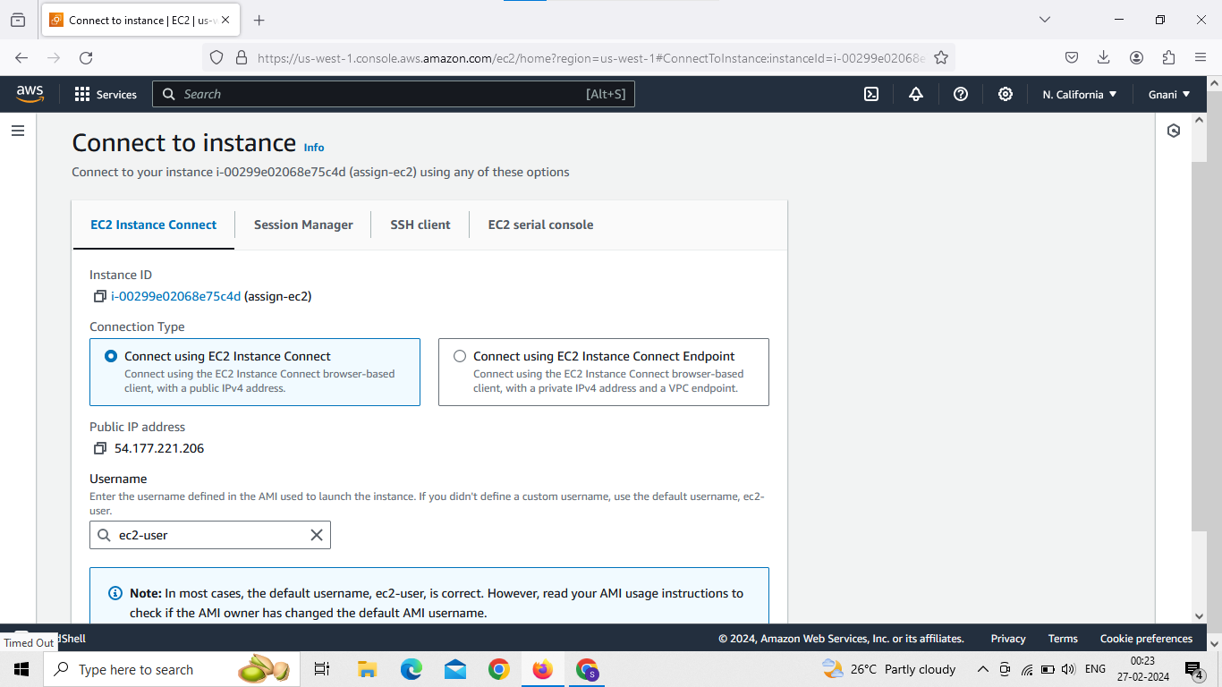
now connect to other account ec2 instance

Slide 26
